Slide 1
Topic 2 / 19111 revision CRS SWG meeting 2017-03-21
Agenda
Future schedule
Doc layout / conformance
Derived CRS
Temporal CRS

Slide 2
Future schedule
Key timelines:
ISO TC211 meeting week of 29th May – 2nd June
Need to obtain buy-in to scope changes
Inclusion of temporal (no threat to ISO 19108)
Inclusion of parametric (currently 19111 part 2)
Possible change of name
ISO editing committee at 2017-11 TC211 plenary
Process comments received on draft following
90 day ballot in ISO
60 days RFC in OGC
to meet ISO 90 days requires final draft submission by end July
Target: 2017-06 OGC TC – vote for RFC
3 week rule: 2017-06-05 ≈ 2017-05-29

Slide 3
2017-03-18 WD - Doc structure
19111:2007
6 Spatial referencing by coordinates — Overview
6.1 Relationship between coordinates and coordinate reference system
6.2 UML model for spatial referencing by coordinates — Overview
Revision
6 Spatial referencing by coordinates — Overview
6.1 Relationship between coordinates and coordinate reference system
6.2 UML schema for spatial referencing by coordinates
7 Coordinate reference systems definition
7.1 Overview
7.2 UML model for coordinate reference system definitions

Slide 4
Conformance
Abstract spec – Modular Spec Requirement / Conformance Classes not needed
But need to guide implementations.
So: Clause 2/ Annex A – conformance “by CRS type”
For Coordinate reference systems definition
For coordinate operations
For Relationship between coordinates and coordinate reference system ???

Slide 5
Derived CRS questions
How do we define a geoid-based vertical CRS?
How do we define a seismic bin grid?

Slide 6
Concepts
CRS = CS + datum
“DerivedCRS is defined by applying a coordinate conversion to a baseCRS”
DerivedCRS = CRS + conversion
DerivedCRS = CS + datum + conversion
“Derived CRS subtype has same CS type as is permitted for CRS of that subtype”
does it?
projected CRS an exception in that it is only ever derived so CS type is defined,
but otherwise, yes
“Derived CRS inherits its datum from its base CRS”
does it?
Geoid-based vertical CRSs don’t do so…

Slide 7
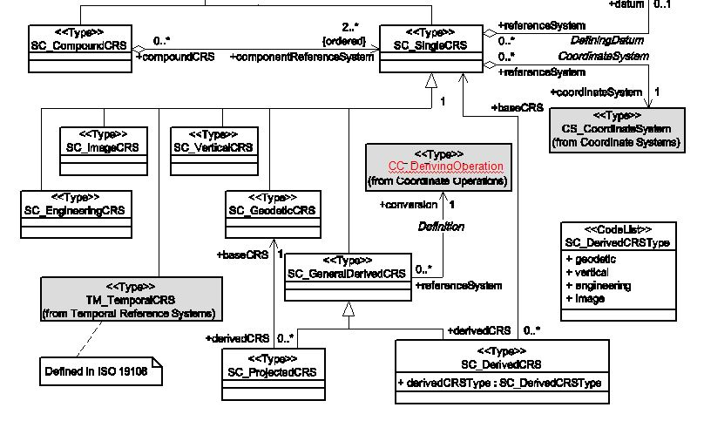
19111 UML model
Modification proposed 2015-06 Southampton
to accommodate:
seismic bin grids
geoid-based vertical CRSs
Proposed modification rejected: conversion and transformation are sufficient.

Slide 8
Geoid-based Vertical CRS
Geog3D ‘base’ CRS
Geodetic datum + ellipsoidal3D CS (φ λ h)
Geog3D ‘base’ CRS #2
(e.g. new reference frame realisation)
Geodetic datum + ellipsoidal3D CS (φ λ h)
+
=
+
=
+
=
Coordinate transformation
geoid model #1
Coordinate transformation
geoid model #2
Coordinate transformation
geoid model #1
Geoid-based Vertical CRS #1
vertical datum + vertical CS (H)
(geoid surface)
Geoid-based Vertical CRS #2
vertical datum + vertical CS (H)
(geoid surface)
Geoid-based vertical CRS is defined wrt a baseCRS by applying a geoid model
Applying the original geoid model to the second baseCRS defines a different vertical CRS.
Analogous to map projection and projected CRS.
Same geoid-based vertical CRS may be defined wrt a different baseCRS by applying a different geoid model
In the sense that these geoid-based vertical CRSs are defined by an operation (the geoid model) they are derived CRSs.
But their datum is not inherited from their baseCRS. So in the current model they are not derived CRSs.
Geoid-based vertical CRS and geoid model / geometric CRS linked only by remarks: is that good enough?

Slide 9
Seismic Bin Grid in ISO19162 (1)
ENGCRS[“seismic survey bin grid”,
BASEPROJCRS["NAD27 / Texas South Central",
BASEGEODCRS["NAD27",
DATUM["North American Datum 1927",
ELLIPSOID
CONVERSION["Texas South Central SPCS27",
METHOD
PARAMETER
:
DERIVINGCONVERSION
METHOD
PARAMETER
:
CS[Cartesian,2],
:]
This is stated to be a derived CRS
it is stated to be an engineering CRS
but it has inherited a geodetic datum
This is inconsistent with existing 19111 definitions for CRS type
if it has a geodetic datum it should be a geodetic CRS
if it is an engineering CRS it should have an engineering datum
So what type of CRS is this?
quadrilateral grid??
Should derived CRS types be related to their CS rather than their datum?
might this also apply to non-derived CRSs?

Slide 10
Seismic Bin Grid in ISO19162 (2)
The CS is stated to be Cartesian
Cartesian is defined in 19111:2007 clause 4 as “coordinate system in Euclidean space which gives the position of points relative to n mutually perpendicular axes”.
19111:2007 Table 15 says “two- or three-dimensional coordinate system which gives the position of points relative to orthogonal straight axes. All axes shall have the same unit of measure.”
19111:2007 Table 18 says “A two- or three-dimensional coordinate system with orthogonal straight axes. In the 2D case, both axes shall have the same length unit; in the 3D case, all axes shall have the same length unit.”
If a bin is rectangular rather than square, does it have the same ‘length unit’ (as opposed to ‘length’)? Is it Cartesian? Are the 19111 definitions and descriptions correct?
ENGCRS[“seismic survey bin grid”,
BASEPROJCRS["NAD27 / Texas South Central",
BASEGEODCRS["NAD27",
DATUM["North American Datum 1927",
ELLIPSOID
CONVERSION["Texas South Central SPCS27",
METHOD
PARAMETER
:
DERIVINGCONVERSION
METHOD
PARAMETER
:
CS[Cartesian,2],
:]

Slide 11
Definitions in 19111:2007
Subtypes of CRS
geodetic coordinate reference system: CRS based on a geodetic datum
vertical coordinate reference system: CRS based on a vertical datum
engineering coordinate reference system: CRS based on an engineering datum
image coordinate reference system: CRS based on an image datum
parametric coordinate reference system: CRS based on a parametric datum
CRS types have datum of the same type!
derived coordinate reference system: CRS which is defined by applying a coord. conversion to a baseCRS (A derived CRS inherits its datum from its base CRS)
Subtypes of coordinate operation
coordinate conversion: coordinate operation in which both CRSs are based on the same datum
coordinate transformation: coordinate operation in which the two CRSs are based on different datums
Or:
conversion: coordinate operation having parameters values that by definition are considered to be error-free
transformation: coordinate operation having parameters whose values are derived empirically (and contain stochastic error)
??

Slide 12
Definitions in 19111:2007 - CRS Clause 4 definitions UML Descriptions
CRS
coordinate system that is related to an object by a datum
[Single CRS] Coordinate reference system consisting of one Coordinate System and either one Datum or one Datum Ensemble (as opposed to a Compound CRS).
CS
set of mathematical rules for specifying how coordinates are to be assigned to points
A coordinate system (CS) is the non-repeating sequence of coordinate system axes that spans a given coordinate space. A CS is derived from a set of mathematical rules for specifying how coordinates in a given space are to be assigned to points. The coordinate values in a coordinate tuple shall be recorded in the order in which the coordinate system axes associations are recorded.
datum
parameter or set of parameters that define the position of the origin, the scale, and the orientation of a coordinate system
A datum or reference frame specifies the relationship of a coordinate system to an object, thus creating a coordinate reference system. For geodetic and vertical coordinate reference systems, it relates a coordinate system to the Earth. With other types of coordinate reference systems, the datum may relate the coordinate system to another physical or virtual object. A datum uses a parameter or set of parameters that determine the location of the origin of the coordinate reference system. Each datum subtype can be associated with only specific types of coordinate reference systems.

Slide 13
Definitions in 19111:2007 - geodetic Clause 4 definitions UML Descriptions
geodetic CRS
coordinate reference system based on a geodetic datumreference frame
A coordinate reference system associated with a geodetic datum and having a geodetic (i.e. Cartesian or spherical) coordinate system.
geographic CRS
geodetic coordinate reference system having an ellipsoidal coordinate system
A geodetic two- or three-dimensional coordinate reference system having a geodetic reference frame and an ellipsoidal coordinate system
geodetic reference frame
geodetic datum
datum describing the relationship of a two- or three-dimensional coordinate system to the Earth
[19111:2007] A geodetic datum defines the location and precise orientation in three-dimensional space of a defined ellipsoid (or sphere) that approximates the shape of the earth, or of a Cartesian coordinate system centered in this ellipsoid (or sphere).
A geodetic reference frame defines the position, scale and orientation of a geocentric Cartesian 3D coordinate system relative to the Earth. It may also identify a defined ellipsoid (or sphere) that approximates the shape of the Earth and which is centred on and aligned to this coordinate system. Older geodetic datums define the location and orientation of a defined ellipsoid (or sphere) that approximates the shape of the earth. Note: In 19111:2007 this class was called GeodeticDatum.

Slide 14
Definitions in 19111:2007 - engineering Clause 4 definitions UML Descriptions
engineering CRS
coordinate reference system based on an engineering datum
EXAMPLES Local engineering and architectural grids; coordinate reference system local to a ship or an orbiting spacecraft.
A contextually local coordinate reference system associated with an engineering datum and which can be divided into two broad categories: - Earth-fixed systems applied to engineering activities on or near the surface of the Earth; - CRSs on moving platforms such as road vehicles, vessels, aircraft or spacecraft.
engineering datum
local datum
datum describing the relationship of a coordinate system to a local reference
Note 1 to entry: Engineering datum excludes both geodetic and vertical datums.
EXAMPLE A system for identifying relative positions within a few kilometres of the reference point.
An engineering datum defines the origin of an engineering coordinate reference system, and is used in a region around that origin. This origin can be fixed with respect to the Earth (such as a defined point at a construction site), or be a defined point on a moving vehicle (such as on a ship or satellite).

Slide 15
Definitions in 19111:2007 - derived Clause 4 definitions UML Descriptions
derived CRS
(no definition)
[19111:2007] A single coordinate reference system that is defined by its coordinate conversion from another single coordinate reference system known as the base CRS. The base CRS cannot be a projected coordinate reference system.
A single coordinate reference system that is defined by its coordinate conversion from another single coordinate reference system known as the base CRS. The derived CRS inherits the datum or datum ensemble of its base CRS.

